Slide 1
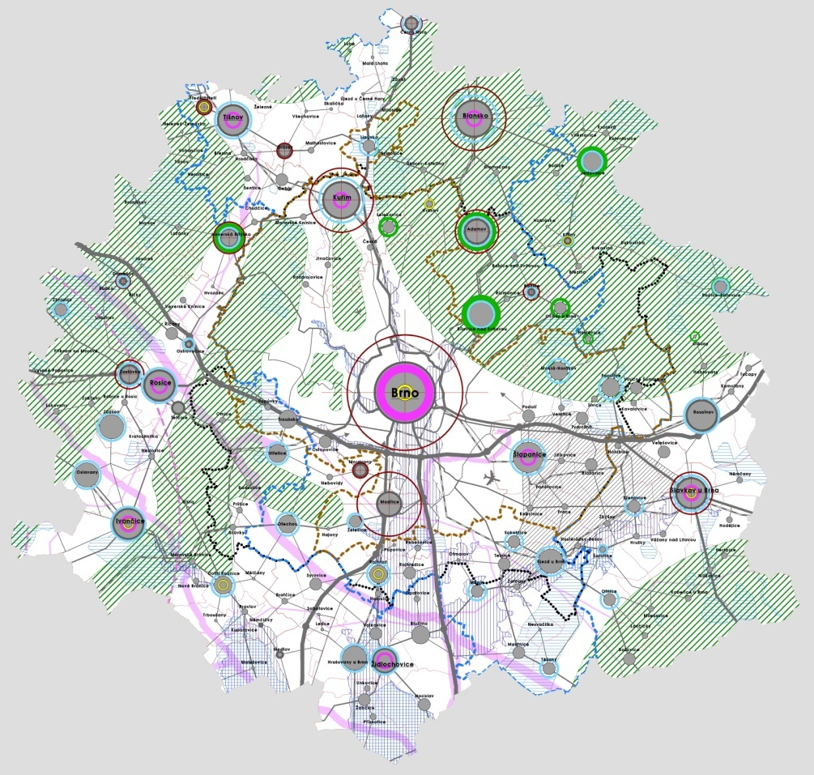


Brno agglomeration and needs for directing its development
- agglomeration within the context of ongoing suburbanisation -

Slide 2
General framework of the development issues of urban agglomerations
Urban agglomerations are spatial units working as a whole regardless the the administrative borders. In these areas there are dominant intemsive relationships between the core cities and the settlement structure of their vicinity. These are relationships that are based on mutual needs in terms of division of labour, where the dominant role is played by centripetal linkages to the cores over centrifugal relationships to other settlements in the vicinity
Urban agglomerations are the drivers of economic development.
Urban agglomerations accumulate most of the inhabitants and economic activities
Agglomerations as functional units established on the basis of mutual advantages and needs are not currently controlled directly
Agglomerations do not have their own political representatives nor direct tools for influencing their development
Still, the agglomerations exist and develop
The question is how their development is directed and if it is rational and efficient in terms of public funds expenditure

Slide 3
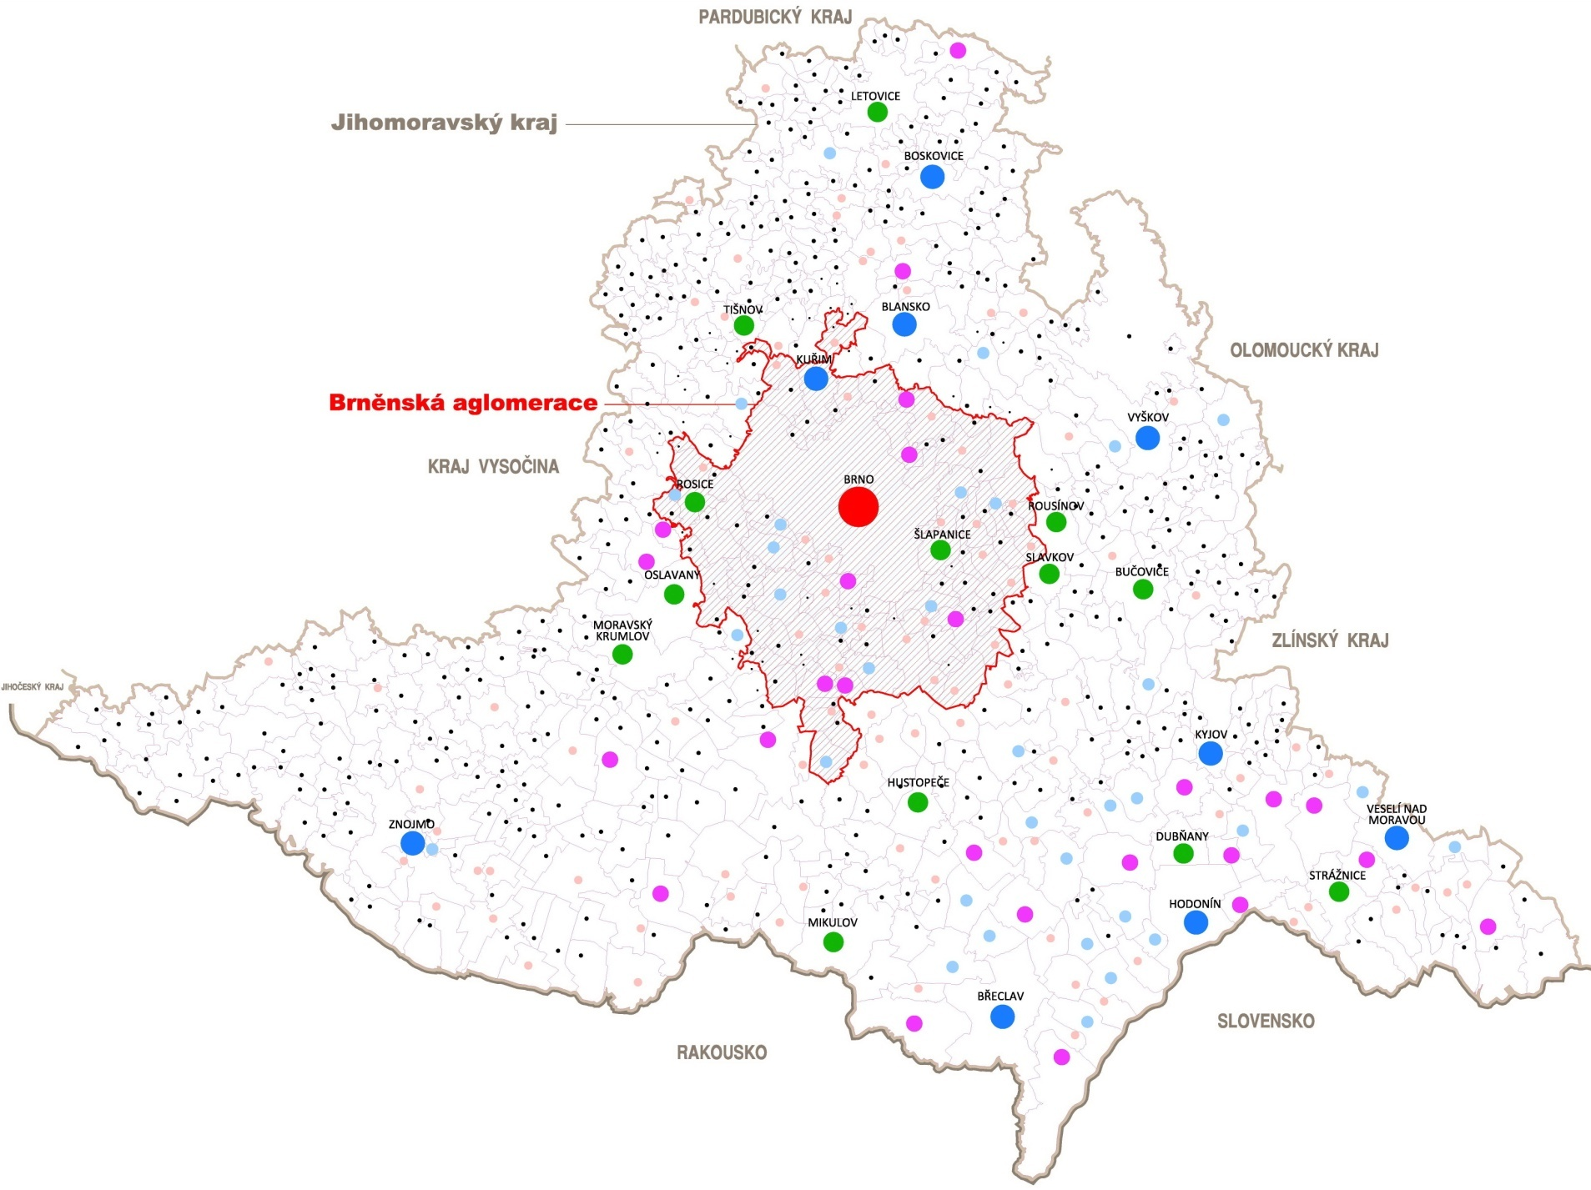
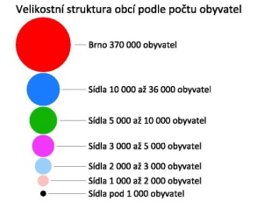
Brno agglomeration
 | Size |  | Municipalities |  | Inhabitants
 | km2 | % | number | % | number | %
South Moravian Region | 7 197 | 100,0% | 673 | 100,0% | 1 151 708 | 100,0%
Brno agglomeration | 982 | 13,6% | 96 | 14,3% | 507 088 | 44,0%

Slide 4
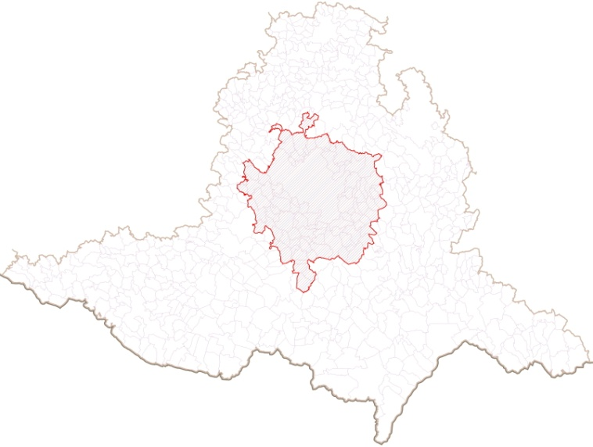
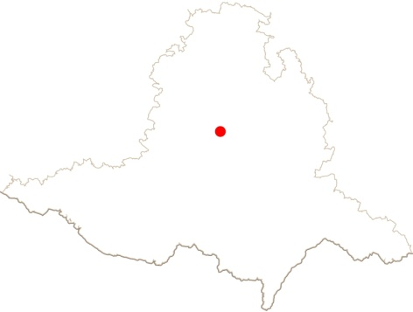
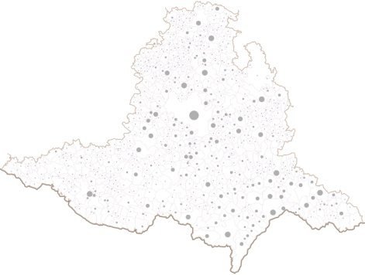
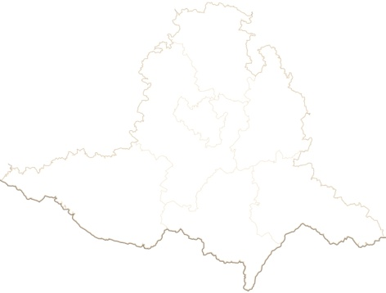
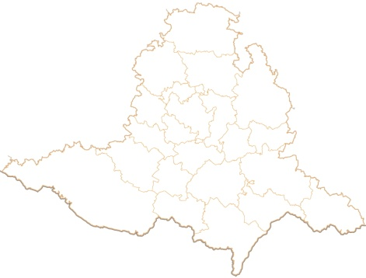
Agglomeration control
Political governance
Brno agglomeration
Regional territory
Regional governance
unions of municipalities
purpose-oriented associations of municipalities
Municipal territories
Municipalgovernance
Public administration
Regional territory
Regional Authority
District territories
District authorities – dissolved in 2003
Municipalities with extended competence
Municial authorities with extended competence
Municipal territories
Municipal authorities

Slide 5
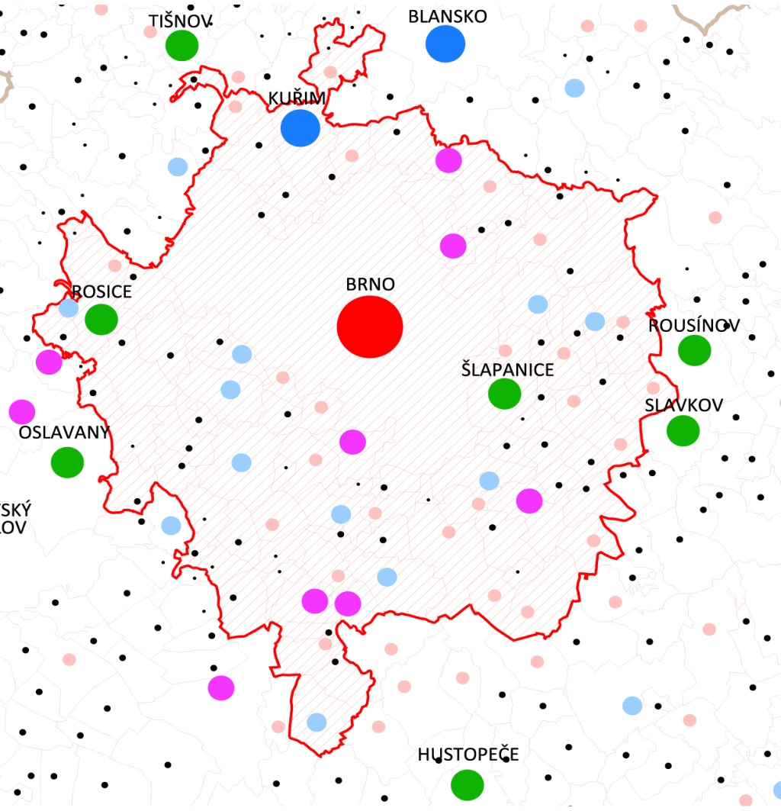
Definition of the Brno agglomeration
Criteria for defining the agglomeration
the share of daily commuting to Brno to the total number of economically active Brno inhabitants is above 25 %
the accessibility of the Brno city centre from the nearby municipalities using public means of transport and individual transport is within a 40-minute time
coherence of the area of agglomeration
The defined Brno agglomeration including Brno covers 96 municipalities forming a single functional unit with very tight every-day work related linkages and linkages to amenities

Slide 6
Brno agglomeration and suburbanisation
Suburbanisation is closely related to the agglomeration development
Suburbanisation is a process of expanding towns necessitating spatial changes in the settlement
Suburbanisation is caused by the resident moving from the central parts of the agglomerations to the outskirts and beyond the administrative borders while keeping close functional relationships with the settlement centres
Suburbanisation is accompanied by concentrating new production and services premises established on the outskirts of the settlements in localities with convenient transport connections
The present suburbanisation serves as an example of a lack of control over the urban development dynamics in the agglomeration, which brings about a number of problems, the solution to which calls for further public investments

Slide 7
Causes of residence suburbanisation
changed behaviour of the society after 1989 (replacement of the controlled processes of urbanisation by processes of uncontrolled suburbanisation)
desire to own a place to live in a good quality environment (meeting the requirements for healthy and tranquil environment set in natural vegetation, effort to detach oneself from the overpopulated stress-prone city)
rising standard of living of some groups of residents and their ability to resolve their housing issues independently (1st suburbanisation wave - prominent people from the past, beneficiaries of restitutions, new entrepreneurs, specific professions – lawyers, physicians, senior officials, 2nd suburbanisation wave – middle-income group using mortgages)
increase in individual mobility (rapid rise in car transport available to a broad spectrum of the residents)
inability of towns to offer enough adequate and available development lots satisfying the housing demand in various forms (problems with ensuring necessary conditioning investments, unclear ownershipp)
increase in land lots prices in cities (land speculation by the landowners, prices of lots do not reflect the necessary investments)
low land lot prices around cities (original low value agricultural land are increased in value by the landowners changing the lots into building lots via the urban master plan with a lower price than the price in the citiess)
land speculation - restitution claims (this is an arising phenomenon of speculating with land that is subject to restitution claims that are bought up on massive scale and the claims are lodged with the Land Registry for united areas in attractive localities that are considered as building lots in the urban master plans )
complicated, lengthy and more expensive housing development in cities
much simpler, shorter and cheaper housing development in small municipalities (this is very often related to unresolved infrastructure and necessary civic amenities, which is revealed after some time)
lower costs of living in the surrounding municipalities compared to the city itself

Slide 8
Consequences of residence suburbanisation
excessiveincreased mobility in the agglomeration requires solutions to the transport infrastructure , both transport by cars and public means of transport (requirements for public budgets)
increase in car traffic deteriorates the quality of the environment in areas adjacent to roads (areas along trunk roads are affected, but the settlement structures of the municipalities in the vicinity is affected, too)
expansion into undeveloped areas is subject to extensive occupation of agricultural land, which changes the landscape in the suburban areas
low intensity of using the suburban areas - hardly serviced by the necessary civic amenities
a new standard of living of the residents of the suburban areas is being created, differing from the original expectations
excessive development in the surroundings of the city indirectly results in the decline of the inner districts of cities (resulting in „brownfields“)
The established residence ring around the centre of the agglomeration causes resistance to any new intervention

Slide 9
Trends in the agglomeration
Trends in the number of inhabitants 1980, 1991, 2001 and 2009
 | Number of municipalities | Number of inhabitants 1980 | Number of inhabitants 1991 | Number of inhabitants 2001 | Number of inhabitants 2009 | Absolute change in the number of inhabitants 1980-1991 | Absolute change in the number of inhabitants 1991-2001 | Absolute change in the number of inhabitants 2001-2009 | Absolute change in the number of inhabitants 1991-2009 | Relative change in the number of inhabitants in % 1991-2009
Brno agglomeration | 96 | 495 059 | 507 058 | 498 112 | 507 088 | +11 999 | -8 946 | +8 976 | +30 | 0,0
Brno | 1 | 371 463 | 388 296 | 376 172 | 370 592 | +16 833 | -12 124 | -5 580 | -17 704 | -4,6
Brno agglomeration without Brno | 95 | 123 596 | 118 762 | 121 940 | 136 496 | -4 834 | +3 178 | +14 556 | +17 734 | +14,9
Evolution of the number of inhabitants in the agglomeration
Evolution of the number of inhabitants in the agglomeration without Brno
Evolution of the number of inhabitants in Brno

Slide 10
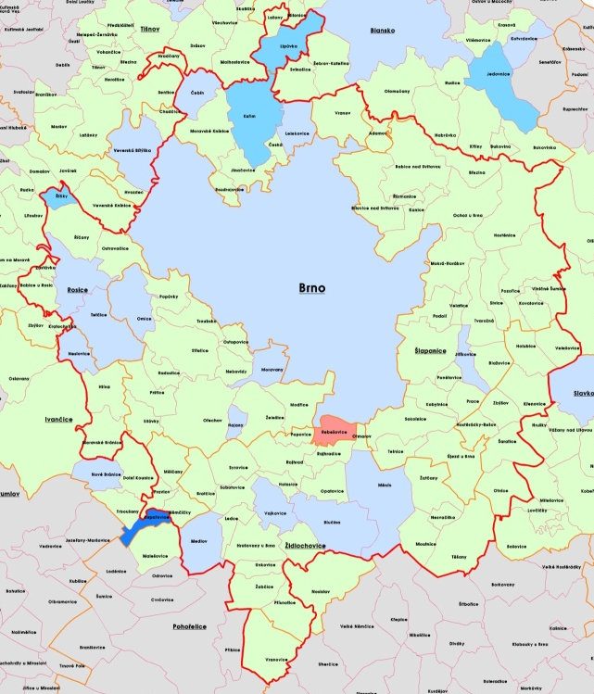
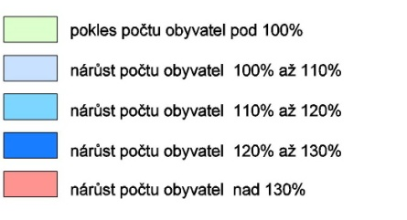
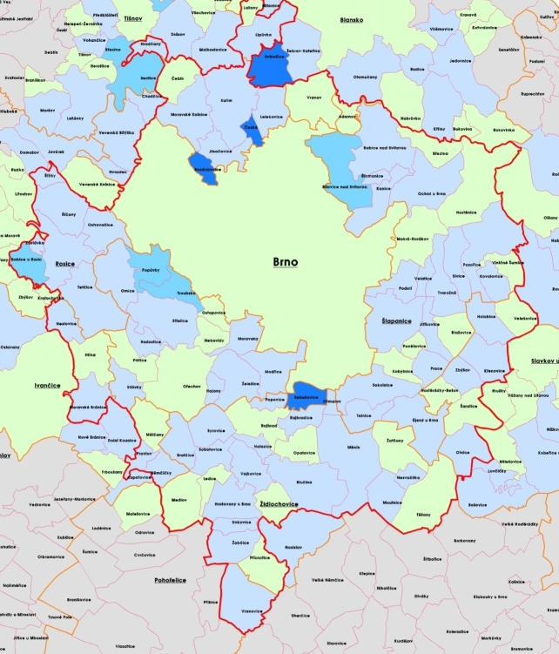
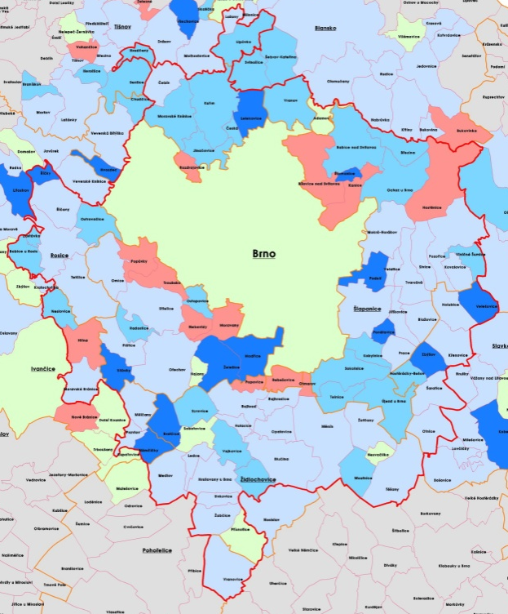

Trends in the agglomeration
Urban development trends before 1989
Trends in the number of inhabitants 1980, 1991, 2001 and 2009
Increase in the centrifugal housing tendency
Evolution of number of inhabitants in 1980 - 1991
Residence suburbanisation trends after 1989
Evolution of the number of inhabitants in 1991 -2001
Evolution of the number of inhabitants in 2001 -2009
Evolution of number of inhabitants in 1991 - 2009

Slide 11
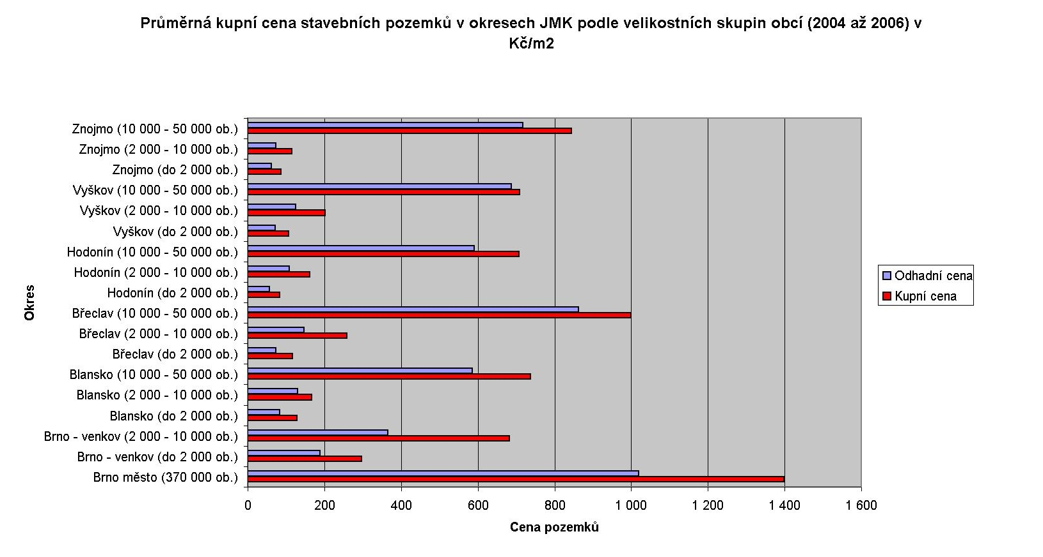
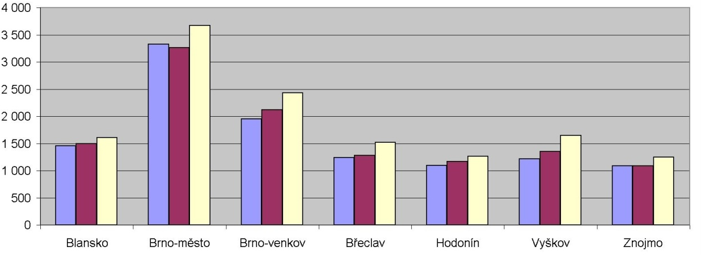

Rise in average prices of detached houses in the SMR districts between 2004 - 2006 (CZK/m3)
Trends in the agglomeration
Prices of building lots and flats in the districts of the SMR in 2004 - 2006
Average purchase price of building lots in the districts of the SMR in 2004 - 2006 (CZK/m2)

Slide 12
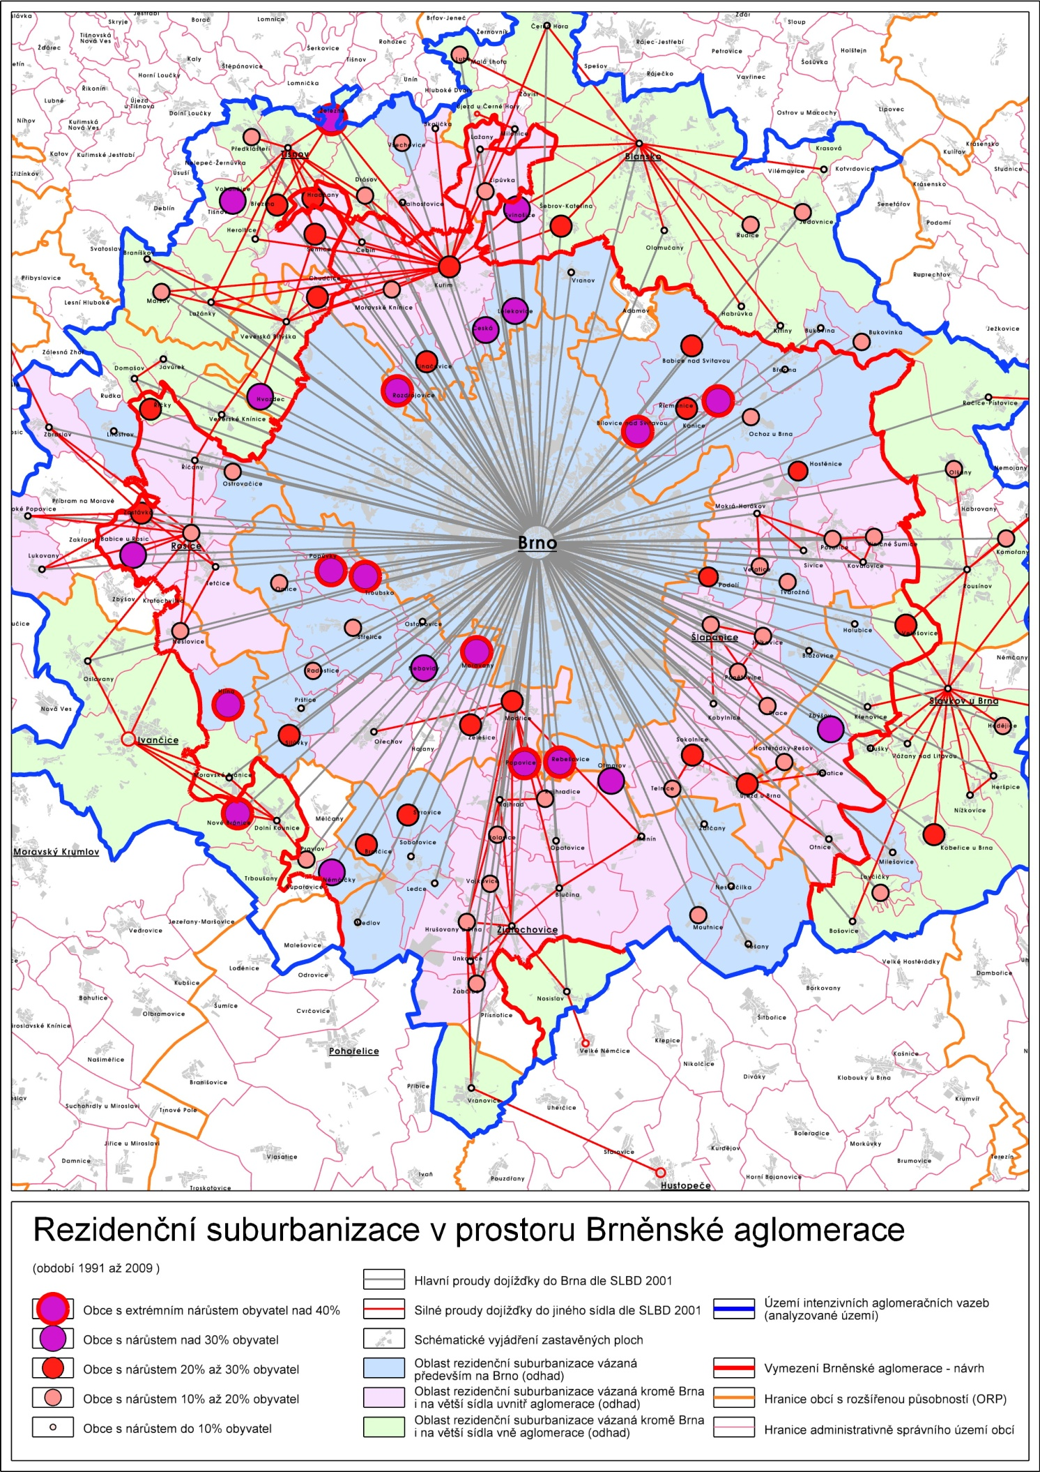
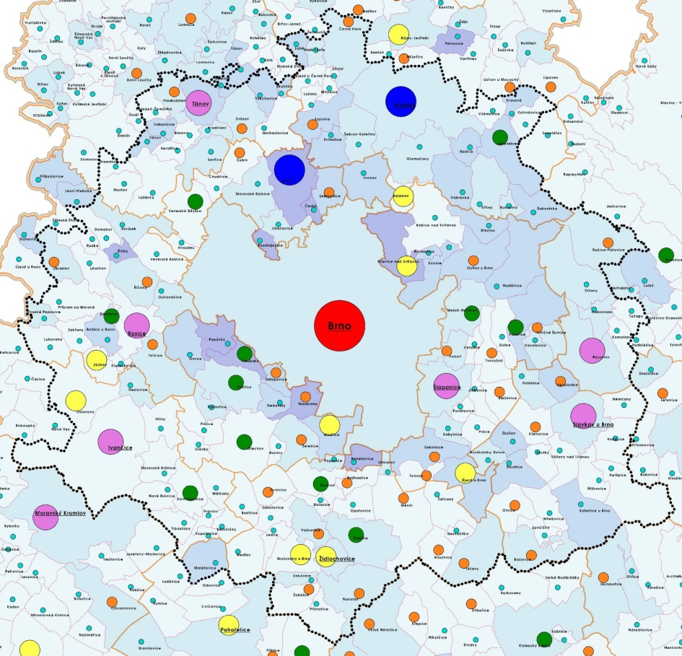
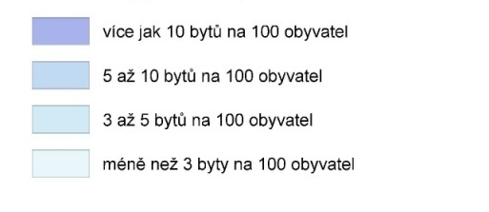
Trends in the agglomeration
Residence suburbanisation
Housing development between 1997 - 2009

Slide 13
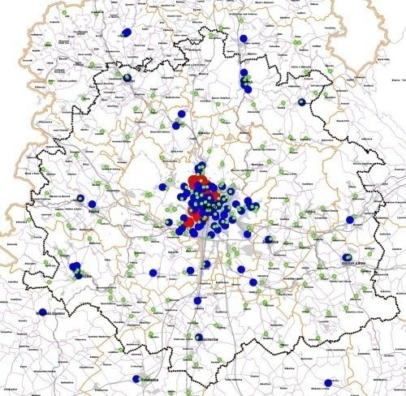
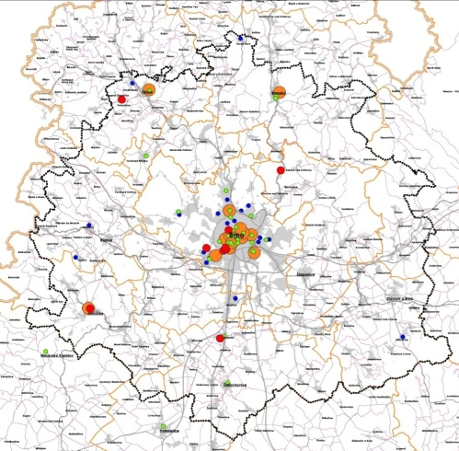
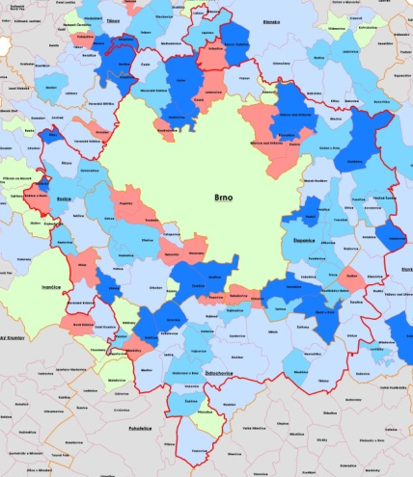
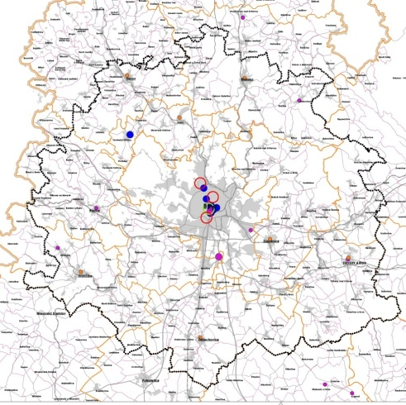
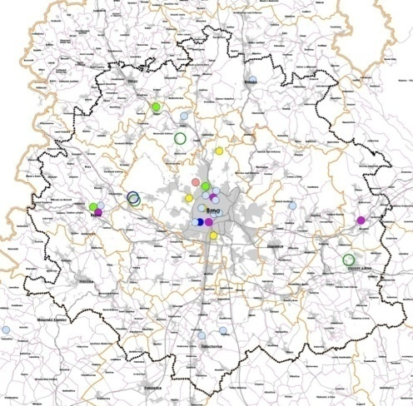
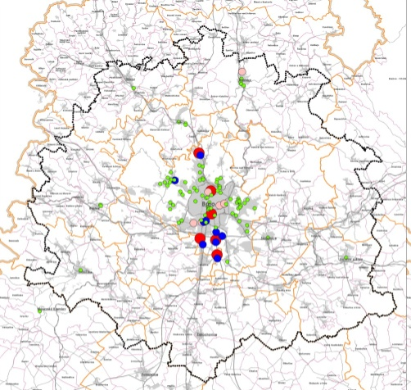
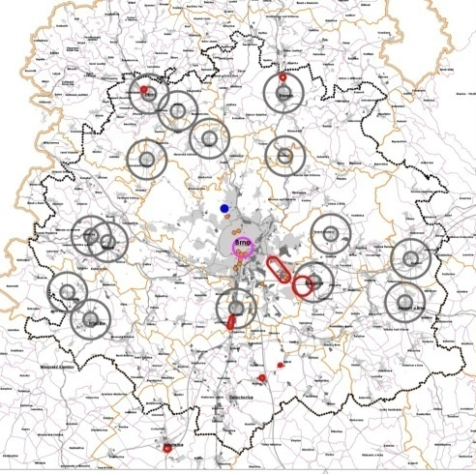
Trends in the agglomeration
Trends of the concentration of civic amenities and work opportunities in the centre of agglomeration
School system
Health care, social care
Housing
Cultural activities
Sports activities
Retails
Job opportunities

Slide 14
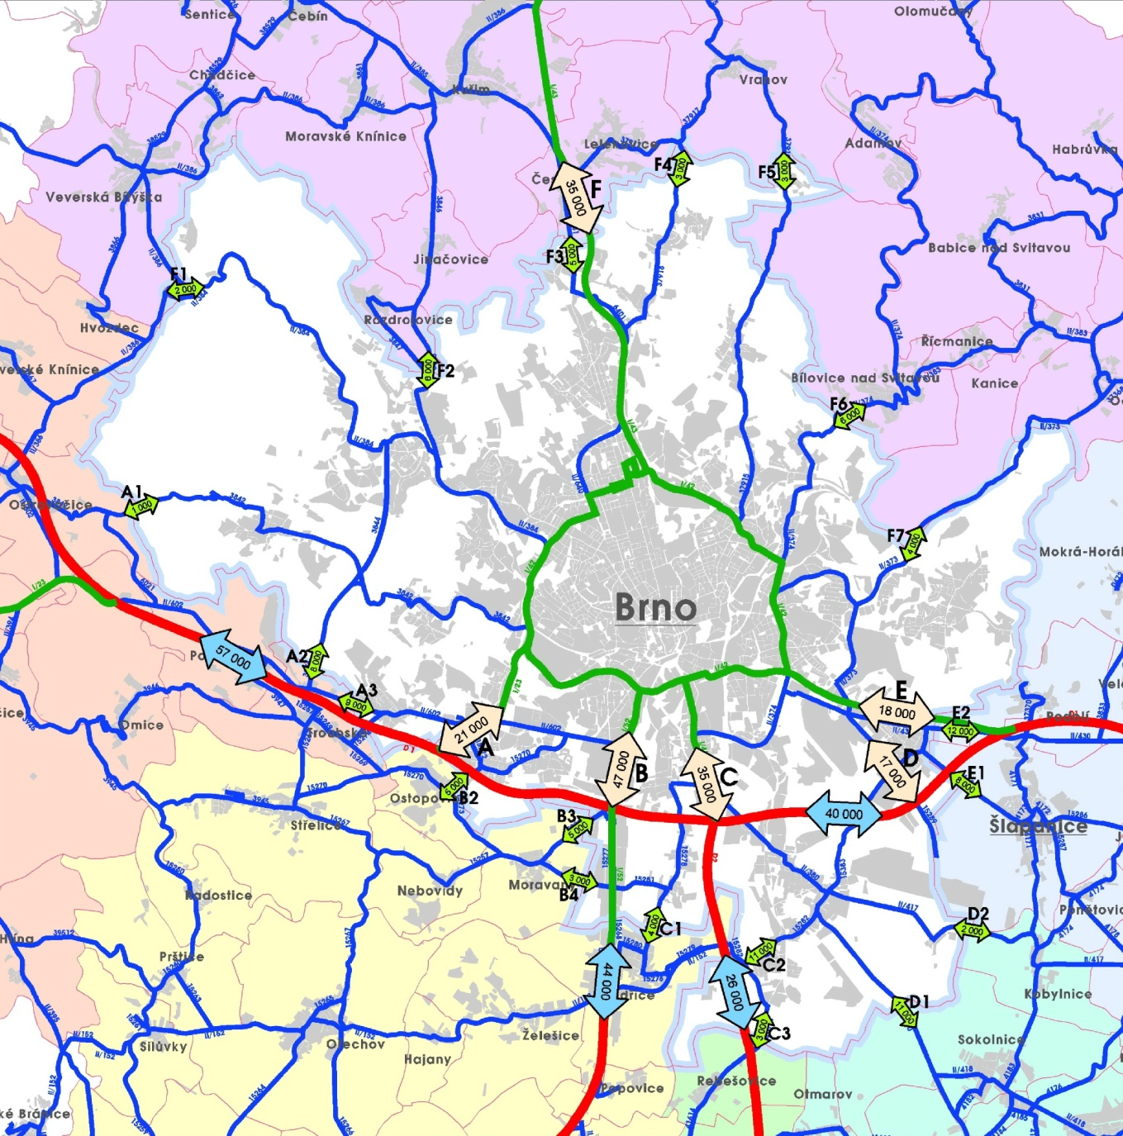
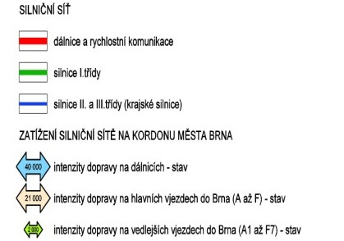
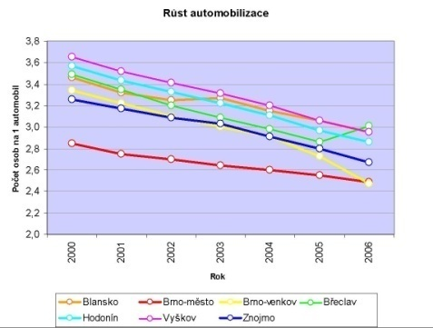
Issues related to vehicle traffic in the agglomeration
Car traffic congestion in Brno
Rising number of cars (number of people/car)

Slide 15
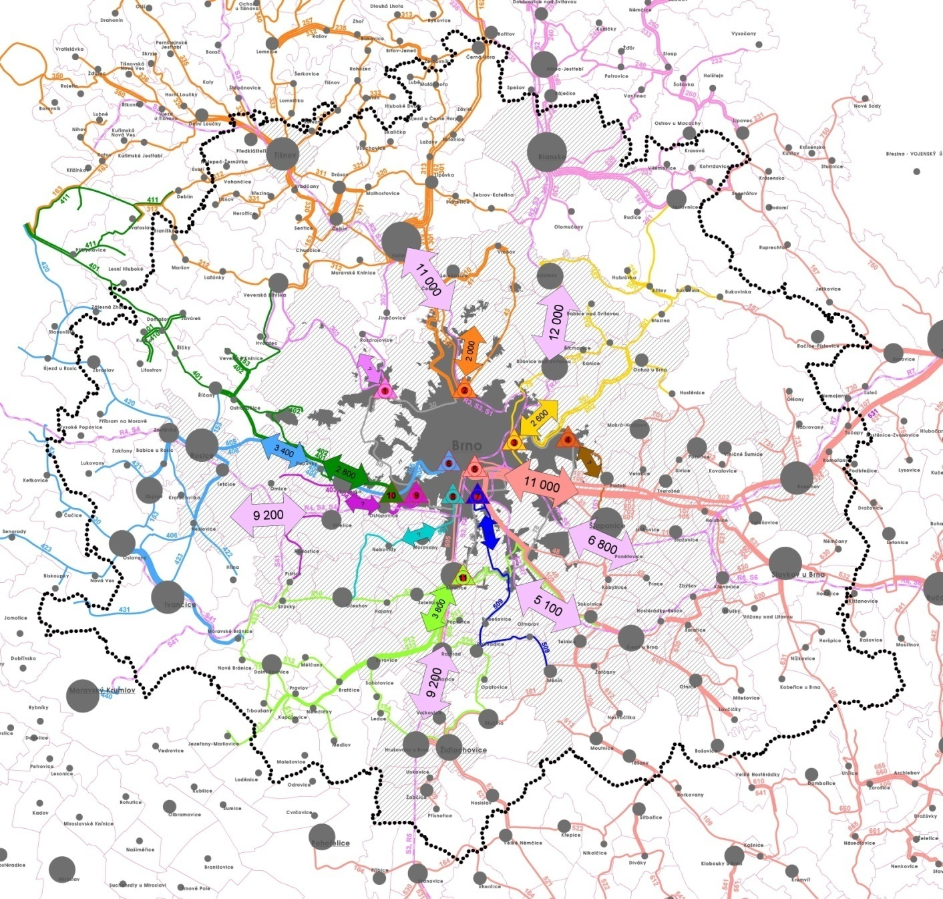
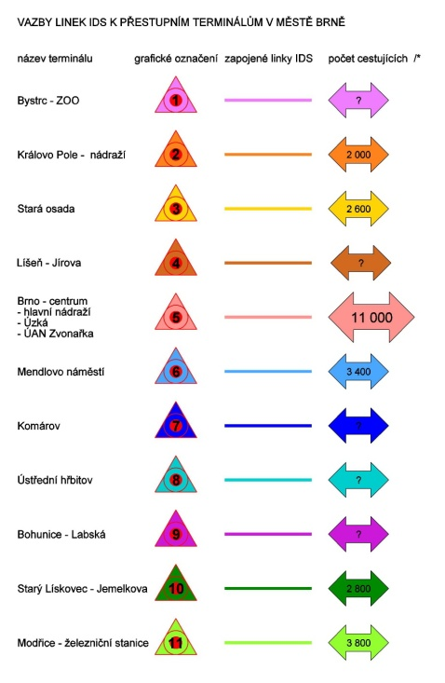
Issues related to public transport in the agglomeration
The whole area of the SR is serviced by an integrated public transport system (IDS) train+ bus
connections of the IDS lines with the public transport hubs in Brno

Slide 16
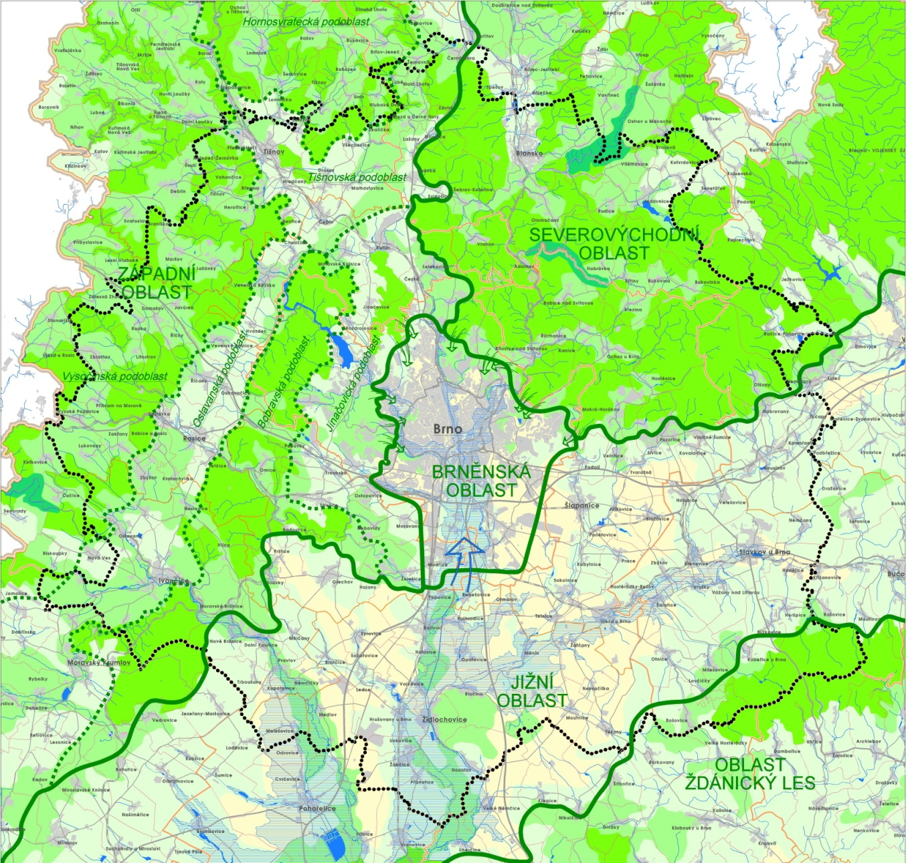
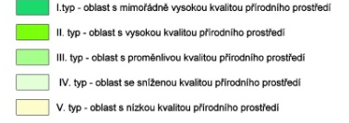
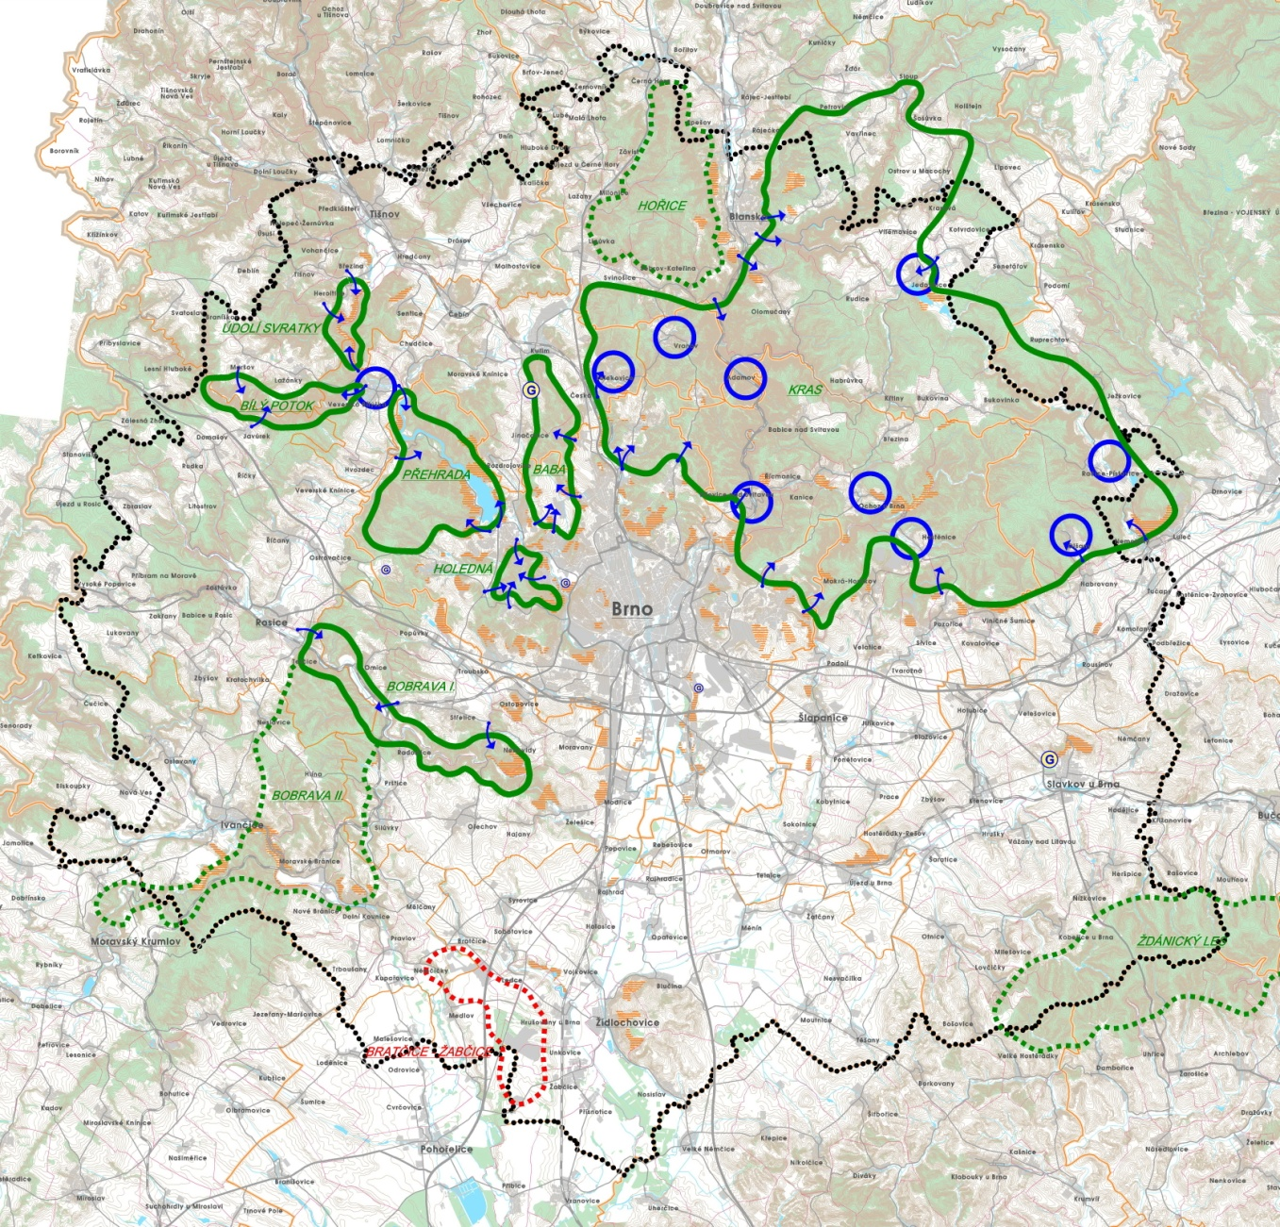
National environment and recreational potential of the agglomeration
Quality of the natural environment
Recreational potential

Slide 17
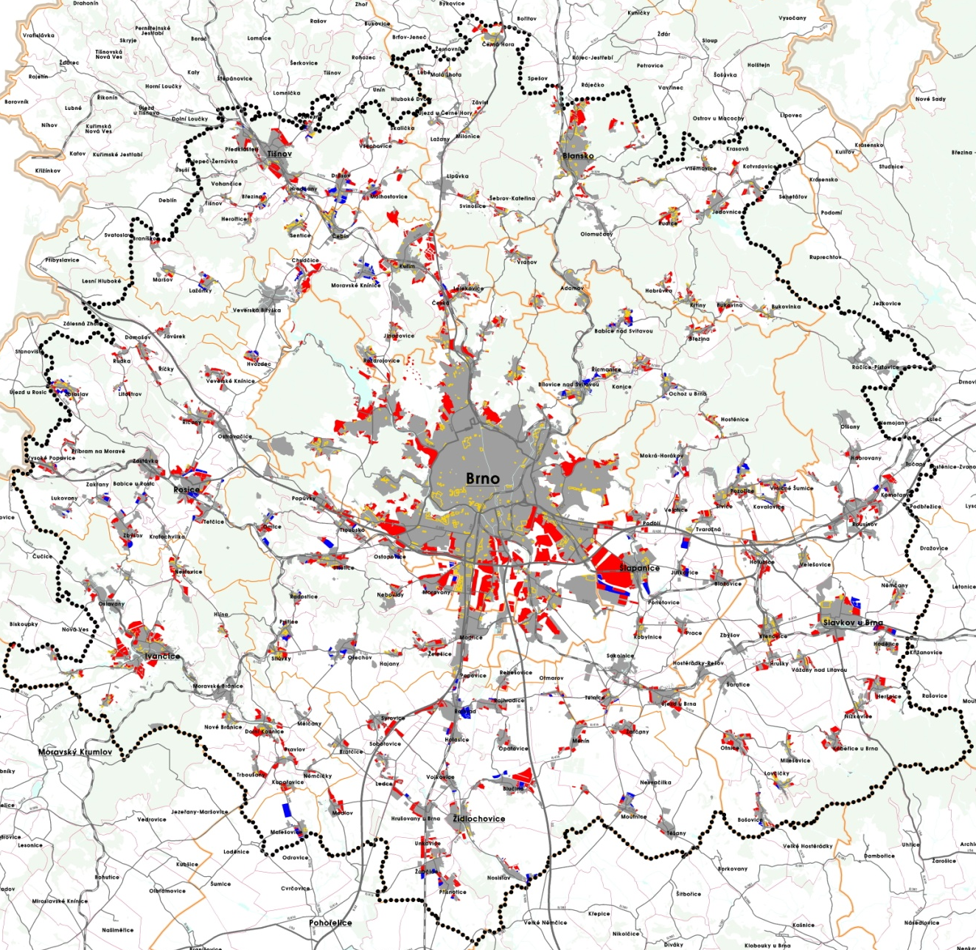
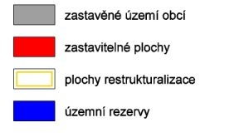
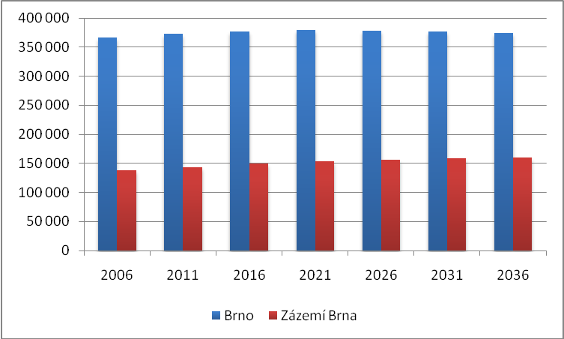
Urban potential of the settlement structure according to the urban plans of the municipalities
Development potential set out in the urban master plans
is several times higher than the expected demographic potential
Demographic forecasts
of the number of inhabitants in the agglomeration between 2006 - 2036

Slide 18
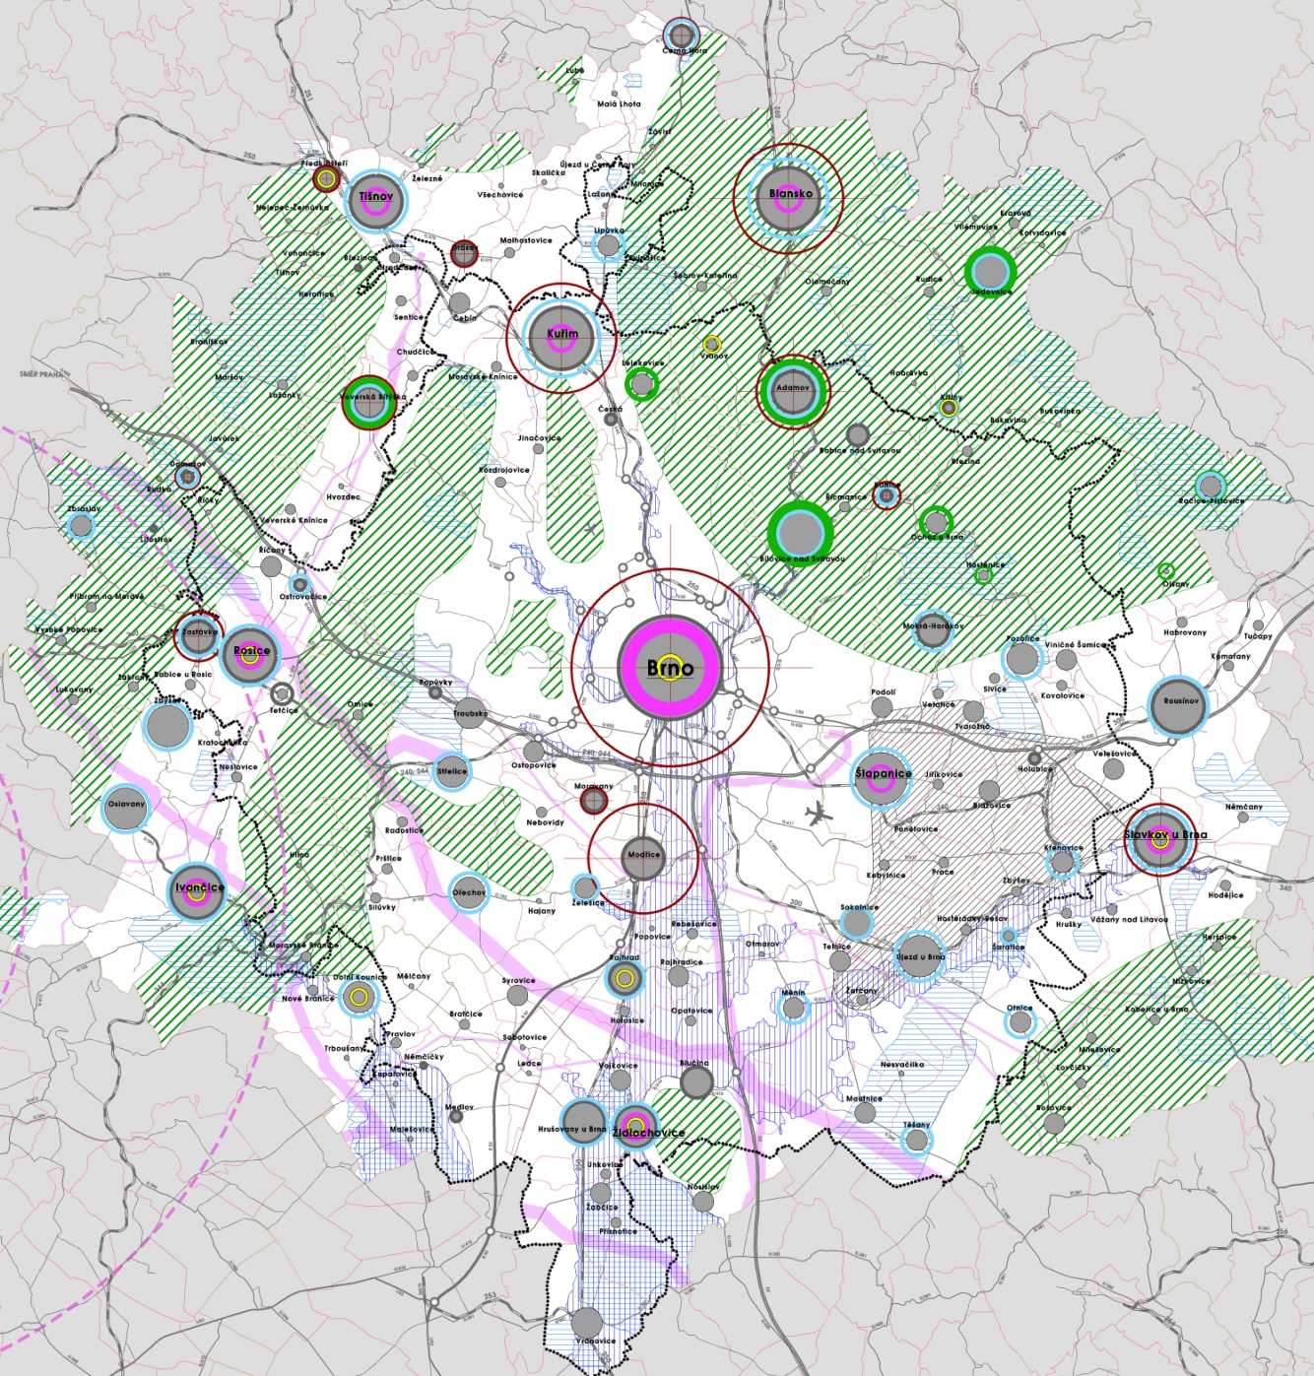
Development restrictions of the Brno agglomeration

Slide 19
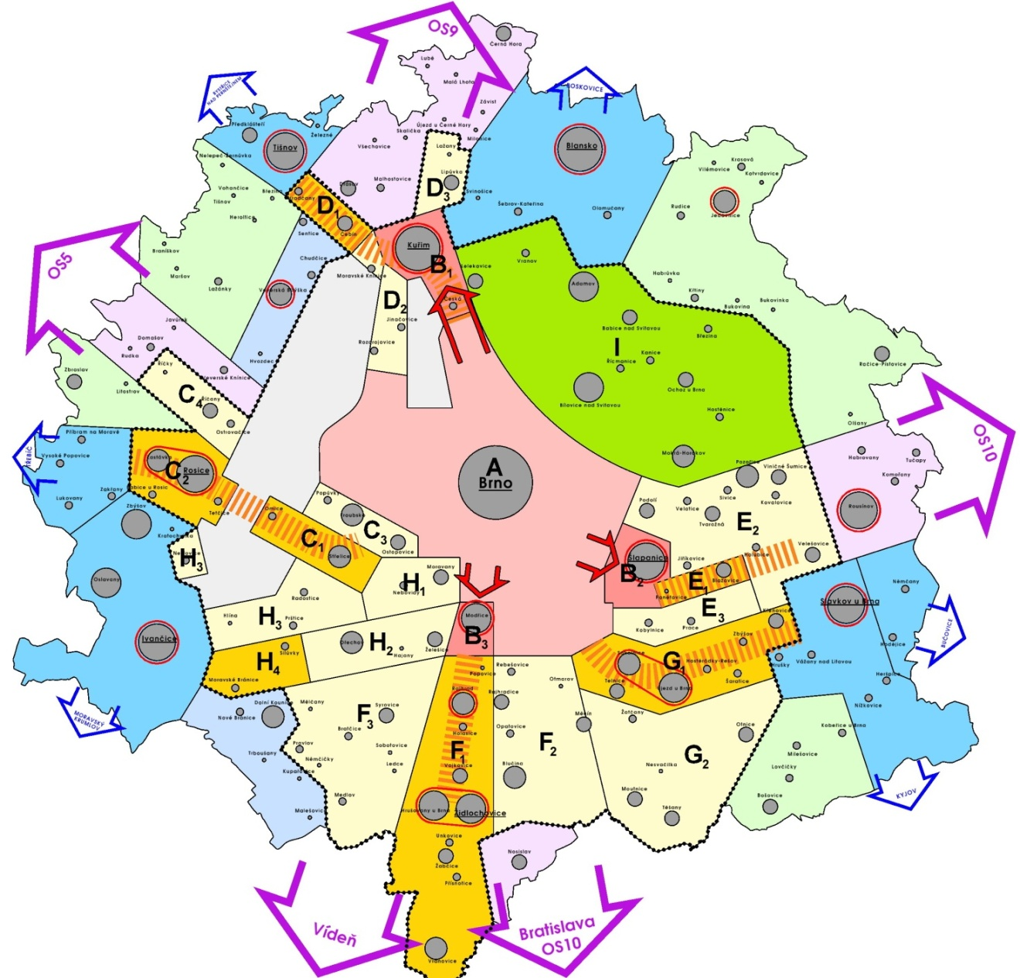
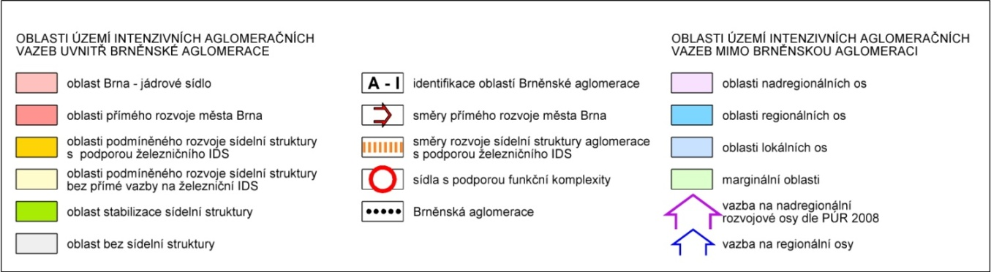
Development principles of the Brno agglomeration
The principles of the Brno agglomeration development are based on the principles of a goal-directed development of the settlement structure corresponding to the potential of the proposed transport and technical infrastructure while respecting the quality of the natural environment and the recreational potential.
The defined principles are set out in the Principles of Urban Development of the South Moravian Region (2011).
  Recommendations aimed at partnerships between the municipalities within the Brno agglomerations are formulated

Slide 20
Thank you for your attention
Ing. arch. Jiří Fixel
Atelier ERA

